Slide 1

Group No: -
A 19
A
seminar on
“Stock Market Prediction Using Machine Learning”
Guide :-
Mr. P.S. Kokare
Co-Guide :-
Mrs. S.N. Magdum
Presented By:-
DHANANJAY PATIL
PRANAV NERKAR
HARSHVARDHAN PATIL
Category: In-house
Department of Electronics & Telecommunication Engineering
Smt. Kashibai Navale College of Engineering, Pune - 41.

Slide 2
AIM
“ To Predict The Price Of Given Stock In Near Future
Using Machine Learning”

Slide 3
ABSTRACT
In this project we attempt to implement a machine learning approach to predict stock prices. Machine learning is effectively implemented in forecasting stock prices. The objective is to predict the stock prices in order to make more informed and accurate investment decisions. We propose a stock price prediction system that integrates mathematical functions, machine learning, and other external factors for the purpose of achieving better stock prediction accuracy and issuing profitable trades. While predicting the actual price of a stock is an uphill climb, we can build a model that will predict whether the price will go up or down.

Slide 4
OBJECTIVES
To Develop a prototype to estimate price of a given stock in near future.
To use Machine Learning Conception to develop the proposed model.
To use LSTM model for the planned system for maximum accuracy.
To develop an algorithm with maximum efficiency.
To develop deep understanding of all the concepts used in proposed model.
To resolve errors or problems if encountered any while making the proposed model

Slide 5
CONTENTS
Abstract
Introduction
Literature Survey
Block Diagram
Hardware/ Software Design
Simulation Results
Advantages/Disadvantages/ Applications
Conclusions
References
Phase Wise Plan

Slide 6
INTRODUCTION
Machine learning (ML) is a type of artificial intelligence (AI) that permits software applications to develop more precise at forecasting consequences without being explicitly encoded to do so. Machine learning algorithms use historical data as input to predict new output values.
These features of Machine Learning (ML) are used in various application like Medical Diagnosis, Speech and Image recognition, Stock-market trading, Self Driving Car, etc.
Our project Stock Market Analysis using Machine Learning is grounded on this solicitation, where Machine Learning along with LSTM Model will be used to analyze a given set of database and will be able to predict the price of a given Stock in Future.

Slide 7
LITERATURE SURVEY
1. Pramod, & Pm, Mallikarjuna. Stock Price Prediction Using LSTM. Test Engineering and Management. (2021).
getting the historical data from market is mandatory step. Then there is a need to extract the feature which is required for data analysis, then divide it as testing and training data, training the algorithm to predict the price and the final step it to visualize the data.
Using the proposed system has help us achieve an accuracy of 96 LSTM units.
It does not take market sentiments into consideration.
2. Shen, J., Shafiq, M.O. Short-term stock market price trend prediction using a comprehensive deep learning system. J Big Data 7, 66 (2020).
The high-level architecture of our proposed solution could be separated into three parts. First is the feature selection part, to guarantee the selected features are highly effective. Second, we look into the data and perform the dimensionality reduction. And the last part, which is the main contribution of our work is to build a prediction model of target stocks.
The proposed system has a lot of features and has a decent accuracy. We can use combination of features by using some features and retaining others to furthermore increase our accuracy.
The RFE algorithm is not sensitive to the term lengths other than 2-day, weekly, biweekly.

Slide 8
LITERATURE SURVEY
3. Shriram. S, Dr. K. Anuradha, Dr. K. P. Uma, 2021, Future Stock Price Prediction using Recurrent Neural Network, LSTM and Machine Learning, INTERNATIONAL JOURNAL OF ENGINEERING RESEARCH & TECHNOLOGY (IJERT) ICRADL – (2021).
The Field of the proposed model is ARTIFICIAL INTELLIGENCE, MACHINE LEARNING, DEEP LEARNING and my model is FUTURE STOCK PRICE PREDICTION USING RECURRENT NEURAL NETWORK, LSTM AND MACHINE LEARNING. The Stock Price prediction model can predict more accurate than other existing models and my project is also different in a way that I had created a Graphical User Interface (GUI) where we can upload the Train data, Test Data and we can get the result of the model and the future 30 days predicted graph with the stock prices
The main Advantage is that since the model uses RNN, LSTM, Machine Learning and Deep Learning models the prediction of stock prices will be more accurate. And, in the model it can predict the future 30 days Stock Prices and it can show it in a graph. Also, the main feature is that the model can show an output of the Individual Predicted Close prices of the Predicted 30 days.
The algorithm mostly runs good except when it comes to shadow or other interference on the road

Slide 9
LITERATURE SURVEY
4. Li, Y., Pan, Y. A novel ensemble deep learning model for stock prediction based on stock prices and news. Int J Data Sci Anal (2021).
we decide to deploy a blending ensemble learning model that combines LSTM and GRU to accomplish this difficult task. The main differences between LSTM and the GRU are the exposure of memory content inside the unit and how new information is processed by each unit. For the LSTM unit, the amount of memory content that is seen controlled by the output gate (not all of the content are exposed to other units; the output gate decides what information will be used in the next LSTM unit).
High accuracy and efficiency
The existing approaches are failed to detect the market sentiments or any sudden news that will be taken into consideration.

Slide 10
BLOCK DIAGRAM
Fig. 1 Block Diagram of Data Logger

Slide 11
BLOCK DIAGRAM DESCRIPTION
Dataset:
Set of all the required data.
Processing of data:
Data will be processed.
Training test split:
estimate the performance of machine learning algorithms.
Construction of predictive model using LSTM:
Constructed A Predictive Model using LSTM Algorithm.
Make Predictions on Stock Dataset:
Predictions are made on Dataset of Stocks.
Evaluate accuracy of prediction:
The Accuracy of Stock price prediction is evaluated.

Slide 12
TECHNICAL SPECIFICATION OF PROJECT
HARDWARE REQUIREMENT
Processor : intel i5 or above
Ram : Minimum 225MB or More
Hard Disk : Minimum 2 GB of space
Input Device : Keyboard
Output Device : Screen of monitor or Laptop
SOFTWARE REQUIREMENT
Operating System : Windows & Linux
IDE : jupyter Notebook
Dataset : .cvc file
Visualization : mat plot lib , pandas
Server : Web Server with HTTP process

Slide 13
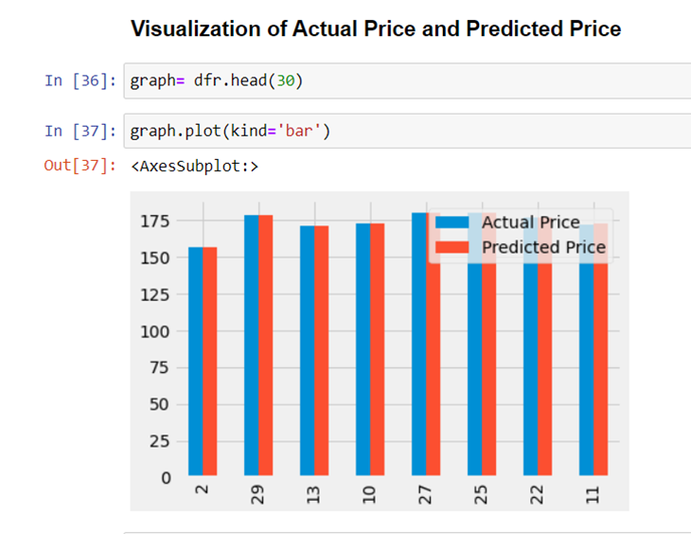
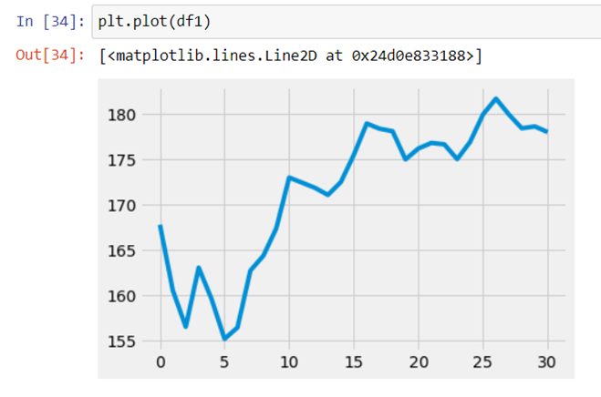
RESULTS

Slide 14
ADVANTAGES, DISADVANTAGES & APPLICATIONS
Advantages
Minimization of Loss as the model will have already predicted the change in trend / decline in price at a particular time.
It will make trading easier for beginners.
Disadvantages
There are going to be many scenarios where this solution will not work.
For example, when there is any sudden news in the market that will be related to the company of whose stock will be traded on.
Applications
The detection and identification of change in trend of any given stock .
Advanced foresight of price movement of any given share

Slide 15
CONCLUSIONS
The smarter solutions help our world to become smarter and have a secure and bright future ahead.
With an optimistic vision our project will help in reduction of losses and maximization of profit.
In this Stock Market Price Prediction project, we use Machine Learning and LSTM model to analyze the past prices of a stock , process it and then forecast the price in upcoming future.
This concept is used to describe the path for Stock Market Trading and to avoid the risk of getting huge losses.

Slide 16
FUTURE SCOPE
Stock Market Price Prediction aims to determine the future movement of the stock value of a financial exchanges , the accurate prediction of share will lead to more profit investors can make.
The Young youth and all people are attracting towards the stock market , hence it will be useful for all this people in future to make accurate investment and profit using this project.
Most of the people will use this to avoid loss as the model already predicted the stock value with maximum accuracy.

Slide 17
PHASE WISE PLAN
Sr. No | Activity | Date | Remarks
1. | Registration of Project Groups | 17/05/2022
2. | Finalization of Project Guide | 18/07/2022
3. | Reporting to Respective Project Guides | 25/07/2022
4. | Discussion of Project idea /Topics (At least 3) | 01/08/2022
5. | Submission of Abstract and Synopsis to project Guides and Project Coordinator in Prescribed Format | 22/08/2022
6. | Literature Survey ( At least 10 IEEE or similar Papers) | 12/09/2022
7. | Simulation Results | 10/10/2022
8. | Presentation on Selected Topic in front of committee members (Ist Presentation) | 29/08/2022

Slide 18
REFERENCES
Pramod, & Pm, Mallikarjuna. Stock Price Prediction Using LSTM. Test Engineering and Management. (2021).
Shen, J., Shafiq, M.O. Short-term stock market price trend prediction using a comprehensive deep learning system. J Big Data 7, 66 (2020.
Shriram. S, Dr. K. Anuradha, Dr. K. P. Uma, 2021, Future Stock Price Prediction using Recurrent Neural Network, LSTM and Machine Learning, INTERNATIONAL JOURNAL OF ENGINEERING RESEARCH & TECHNOLOGY (IJERT) ICRADL – (2021).
Li, Y., Pan, Y. A novel ensemble deep learning model for stock prediction based on stock prices and news. Int J Data Sci Anal (2021).

Slide 19
THANK YOU.

